Slide 1

Melody and Chords
Music Corps, June 2019
humansinharmony.org
Notes:
welcome everyone

Slide 2
Schedule
Orientation and introduction with student interns
  Week 1: June 11
Brainstorming, storytelling, song structure, lyrics
  Week 2: June 18
  Invite a community member from your organization to join you in this session as well as following sessions
Lyrics and melody
  Week 3: June 25
Melody and instrumentals
  Week 4: July 2
Instrumentals and workshopping
  Weeks 5-6: July 9-16
Recording
  Week 7: July 23
Performance
  Week 8: July 30
  Song-sharing performance at a host organization theater, open to all participants, community members, organization staff, and wider community
Notes:
So I wasn’t able to show you this last time, but here is the the schedule! We are now in Week 3 so I will be talking about chords and melody for today

Slide 3
Step-by-Step Guide to Songwriting
Record and perform song
Add chords, beats, instrumentals
Create a melody
Write the lyrics
Learn and discover
Notes:
Yet another graphic I could not show you, but yesterday we started these first two boxes, discovering and lyrics. Today we are already starting the 3rd step! This step is all about adding the actual music to your song. To start this process we present to you 2 options
Before I get into it, I just want to preface this by saying that these two options are not the only options you are restricted to using. Feel free to do things your own way if it works better for you.

Slide 4
2 Options
Option A: Start with melody
Option B: Start with chords
Sing your lyrics and explore
What style are you comfortable with?
E.g., Singer-songwriter, folk, hip hop, rock, spoken-style, musical
Common chord progressions: https://www.hooktheory.com/theorytab/common-chord-progressions
Try out some chords: https://www.hooktheory.com/hookpad/new
Piano, guitar, etc.
Notes:
Option A: Start with melody
Sing your lyrics and have fun exploring! Don’t worry if you feel you don’t know what you’re doing—just as we all started writing with practice, you’ll find you can sing if you try! You can sing in the style you feel most comfortable with. Whether rap, spoken-style, rock, musical, folk, etc., do what is most comfortable for you
Option B: Start with chords
It may be easier to find a melody with some chords in place. If you (or a friend) play an instrument like piano or guitar, try starting with chords.
If you don’t have a songwriting instrument, you can use this site, https://www.hooktheory.com/hookpad/new, to play around with chords! One suggested chord sequence is C, G, a, F. Check out this site, https://www.hooktheory.com/theorytab/common-chord-progressions, for some common chord sequences.
Feel free to play around with the chords to see how they could fit into the lyrics. Then start singing along–try exploring and you may find it is easier to find a melody with some chords ready in the background.

Slide 5

Melody

Slide 6

Start Singing!
Start humming some melodies!
What style do you want the song to be in?
Record yourself and refer back to it
Try to build the intensity to the chorus
Notes:
Start to explore a melody that you want to sing. Some of you have already done this. If you are having trouble, first think of the style you want to sing. It could be rap, opera, classic rock, whatever you want! Be sure to record yourself singing too so that you don’t forget it. It is also good to try and build the melody to the chorus.
Once you have your melody, it is time to get some chords behind it!

Slide 7
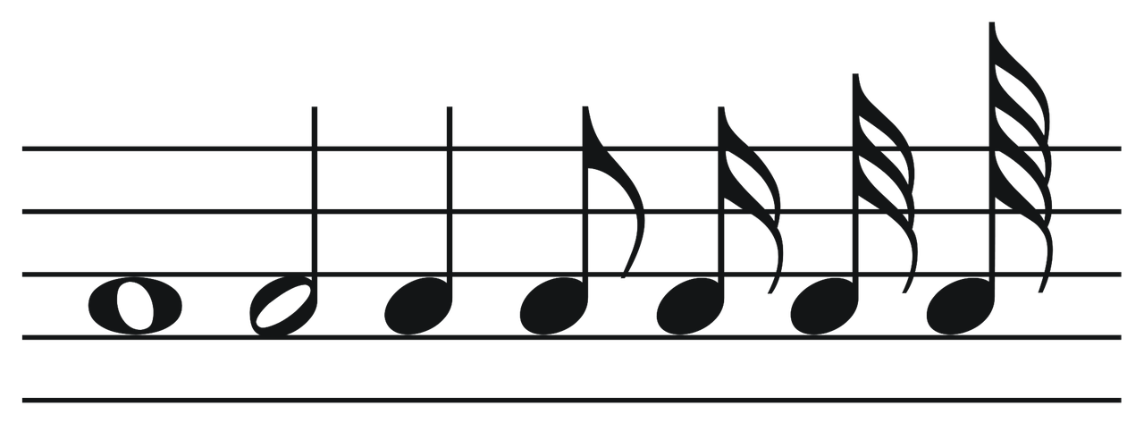
Getting the Chords
Now that you have your melody, what will the instruments play?
Match chords to your melody
Start to play chords and see what works!
Notes:
If one of you have an instrument, start to play some chords while singing and see what you all like. Be sure to document what chords you are playing though!

Slide 8

Scorecloud
Another way to find your chords is to use ScoreCloud
Record your melody and upload it
Then click “analyze” and then “auto-chords”
https://scorecloud.com/
Notes:
On the other hand, you could let the computer do it! If you record your melody and put it on scorecloud, it can give you chords for the melody.

Slide 9
Chords
Notes:
Now let’s say you would rather start with chords

Slide 10
Chord Progression
What chords you want in what order
Every song has a chord progression
Start playing chords and see which ones you like
Try to put different chords together in a certain order.
Notes:
The first thing you need to find is a chord progression to use. A chord progression is just different chords put into an order. Every song has one, which means that you can use the one from your favorite song.

Slide 11

HookTheory
Use HookTheory to find the chord progression you like
You can customize the chords you want and what order you want them
Common chord progressions: https://www.hooktheory.com/theorytab/common-chord-progressions
Make your own chord progression: https://www.hooktheory.com/hookpad/new
Notes:
Or you can use technology! Hooktheory has lots of popular chord progressions, pick your favorite.

Slide 12

Find the Melody!
Start singing what sounds good!
Play the chords and use your creativity to find a melody!
Try to make the melody build to the chorus, with the verse being the foundation
Notes:
Now use these chords to find a melody, the tips from the melody section apply here as well, but this time you have chords ot help guide the creation of the melody

Slide 13
Personal Experiences
David and Kabi on melody and chords
humansinharmony.org
Notes:
welcome everyone

