Slide 1

Orientation
Music Corps, June 2019
humansinharmony.org

Slide 2
Orientation Goals
To clarify the structure of the next 8 weeks
To prepare you for future endeavors
To help you foster relationships with community members

Slide 3




Music Corps
Volunteering with host organization
Writing a song with a community member
Perform and record the song with them

Slide 4



Goals of Music Corps
To harness creative energy toward public good through music.
To learn from one another (Community members and other interns)
To foster engagement and connection through music and service
Music Corp
Intern
Community
Member

Slide 5

Music is for connection, for collaboration,
and for all.
Collaborative songwriting
is a transformative
service experience.
Music + Service
= Engagement

Slide 6
Future Sessions
3 hours with 2 parts
2 hours - Workshopping songs, skill sharing, and lunch with community members
Community members will then leave
1 hour - reflection and discussion we will have a blogposting option for reflecting on your experiences

Slide 7
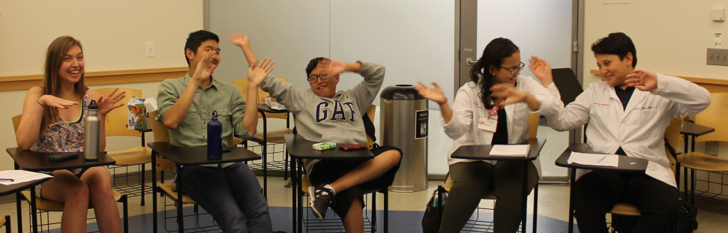
Share a Skill
Share a skill or topic that you are passionate about!
Will be put on our website for future chapters to use

Slide 8

Connections Through Media
Take plenty of photos and videos
Doesn’t have to be formal
Could be made into a music video!

Slide 9

Conversation Guide
To aid you in building relationships
Be sure to ask deeper questions as well
Encourage you to move past the guide

Slide 10

Songwriting Guide
To aid you in the songwriting process
We will go in-depth on a section each week
Use as much or as little as needed!

Slide 11
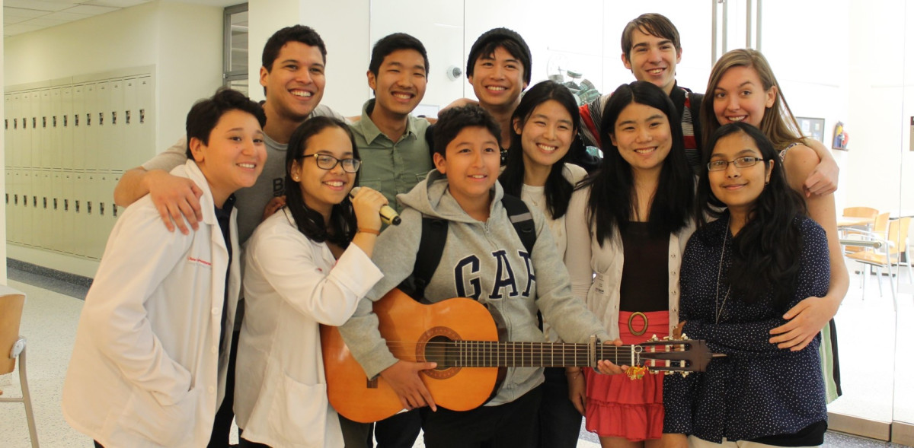
Let us be Your Resource!
Use our materials for your own activities.
The workshops are here to guide you in the right direction!
Resources will be available
online

Slide 12
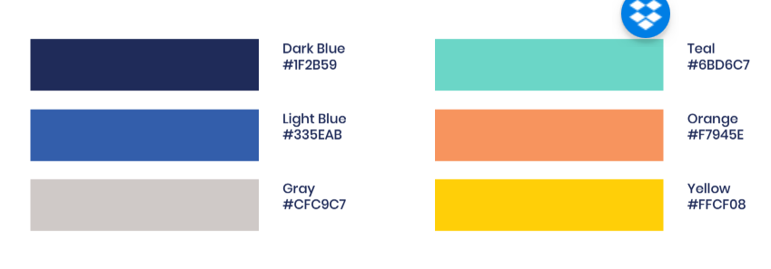
Thank you!

