Slide 1

Storytelling and Lyrics
Music Corps, June 2019
humansinharmony.org

Slide 2
Schedule
Orientation and introduction with student interns
  Week 1: June 11
Brainstorming, storytelling, song structure, lyrics
  Week 2: June 18
  Invite a community member from your organization to join you in this session as well as following sessions
Lyrics and melody
  Week 3: June 25
Melody and instrumentals
  Week 4: July 2
Instrumentals and workshopping
  Weeks 5-6: July 9-16
Recording
  Week 7: July 23
Performance
  Week 8: July 30
  Song-sharing performance at a host organization theater, open to all participants, community members, organization staff, and wider community

Slide 3
Step-by-Step Guide to Songwriting
Record and Perform song
Add chords, beats, instrumentals
Create a melody
Write the lyrics
Learn and discover

Slide 4
Step-by-Step Guide to Songwriting
Record and perform song
Add chords, beats, instrumentals
Create a melody
Write the lyrics
Learn and discover

Slide 5

Conversation and Story
Important story or meaningful experience
What’s a message you want to spread?
Is there a certain memory that you think
could be put into song?

Slide 6
Conversation Time!
Get to know each other!
Use the song idea form to discuss things that will be useful for creating the song.
Find some aspects you have in common! These could help you write the song

Slide 7

Find a Keyword/Theme
Pick a theme or word for the song to be based around
Can be found by thinking of the message you
want the song to have
Examples: gratitude, loss, joyousness, remorse

Slide 8

Start Writing!
Start writing out whatever comes to mind, even if
you don’t end up using it
Imagine you are writing an essay
Hash out your idea and make it more specific
Think of how you want to put your story into words - is there a special phrase you want to keep?

Slide 9
Step-by-Step Guide to Songwriting
Record and Perform song
Add chords, beats, instrumentals
Create a melody
Write the lyrics
Learn and discover
Notes:
Now that you have the idea and have expanded it, we can start creating the lyrics

Slide 10

Add Structure
Decide how you want the song to be structured
Perspective:
Will you use 1st (I), 2nd (you), or 3rd (he/she/they)?
Style:
Verse / chorus / verse / chorus / bridge / (verse) / chorus
Verse / chorus / verse / chorus / verse ...
Verse / verse / bridge / verse

Slide 11
Verse and Chorus
Verse
Chorus
Tells the story and the details
Words change but melody usually stays the same
When I find myself in times of trouble
Mother Mary comes to me
Speaking words of wisdom, let it be.
General message that is repeated
Words and melody stay the same
Let it be, let it be,
Let it be, let it be.
Yeah there will be an answer, let it be.
The Beatles, “Let it Be”

Slide 12
Example: “Ticket Back Home”
Verse 1
Six years old and in the snow
My mittens holed, my fingers cold
Off to school
Off to school
Ready to grow and leave this town
My gaze, it dropped, and I looked down
Your hand in mine
Your hand in mine
Chorus
The train of time it chugged on by
A ticket to something more
The life I always thought I wanted but now I’m dying for
The train of time to take me to
the life I used to know
Please give me a ticket back home
Please give me a ticket back home
Verse 2
Eighteen winters came on through, snow boots
To work boots on feet that grew
Before I knew
Before I knew
New apartment, brand new bed
Thoughts of home race through my head
Thoughts of you
Thoughts of you
Chorus
The train of time it chugged on by
A ticket to something more
The life I always thought I wanted but now I’m dying for
The train of time to take me to
the life I used to know
Please give me a ticket back home
Please give me a ticket back home
Verse 3
Sixty years they came and went
But the past I can’t forget
The home I knew
The home I knew
Like water in my palm, they dropped
The sands of time they’ve never stopped
I beg them to
I beg them to
Chorus
The train of time it chugged on by
A ticket to something more
The life I always thought I wanted but now I’m dying for
The train of time to take me to
the life I used to know
Please give me a ticket back home
Please give me a ticket back home
Please give me a ticket back home

Slide 13
Rhymes
Rhymes can add uniqueness to your song and can help you get started on your lyrics
Rhyming lines in different ways can add a different feel to the song
Words don’t have to be perfect rhymes—for example, “time” and “light” sound similar but aren’t perfect rhymes

Slide 14
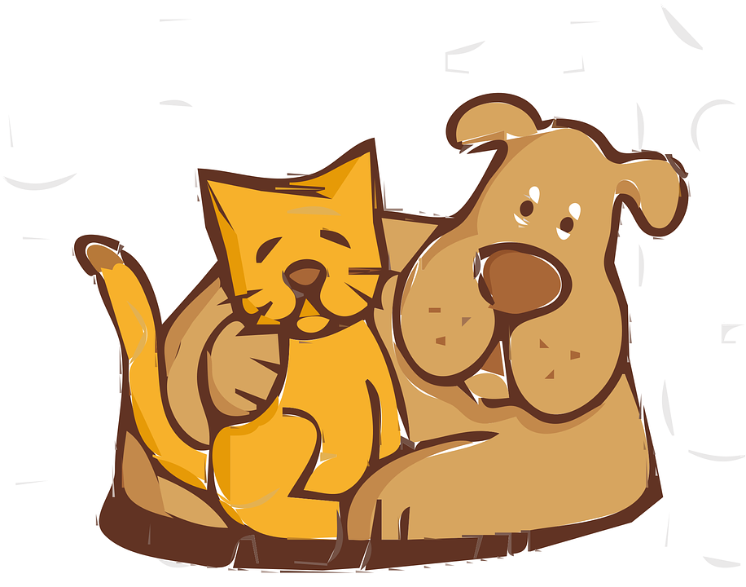
Rhyme Schemes
ABAB
Cat, Dog, Mat, Log
AABB
Hat, Pat, Hog, Fog
ABCB
Rat, Car, Mouse, Star
There are many types of rhymes, but here are just a few

Slide 15
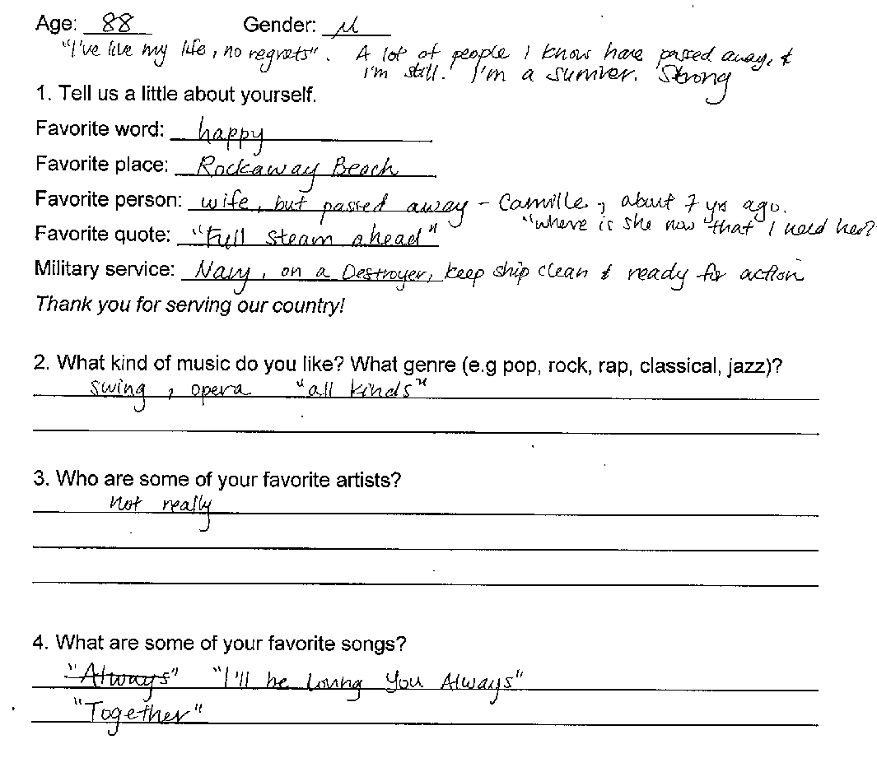
Ask yourself these questions as learn about your storyteller:
Who is this person?
What kind of music do they like?

Slide 16
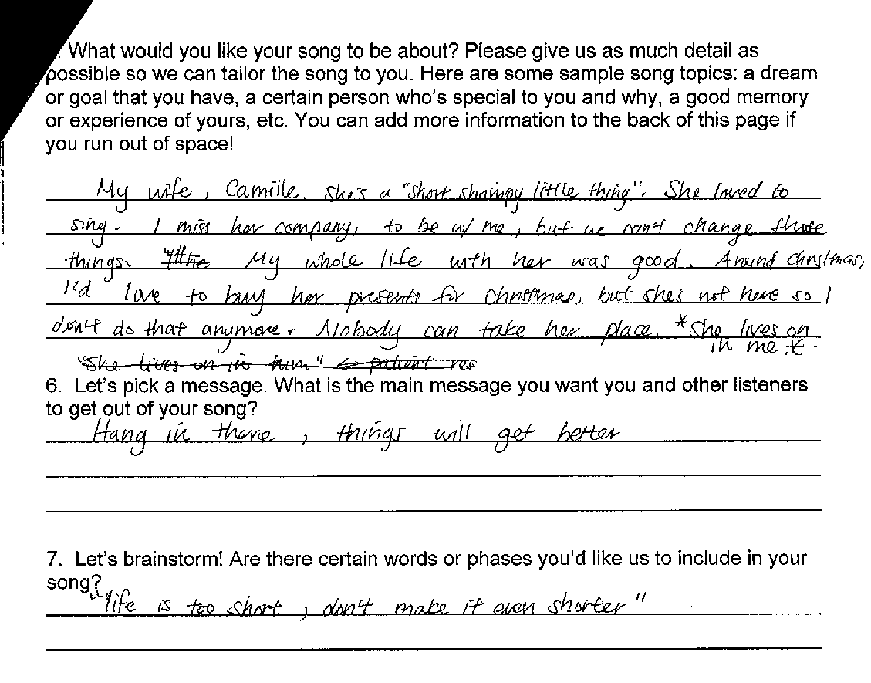
Why are they telling this story?
What experiences do you and your storyteller share?
What key words describe your storyteller’s experiences?

Slide 17
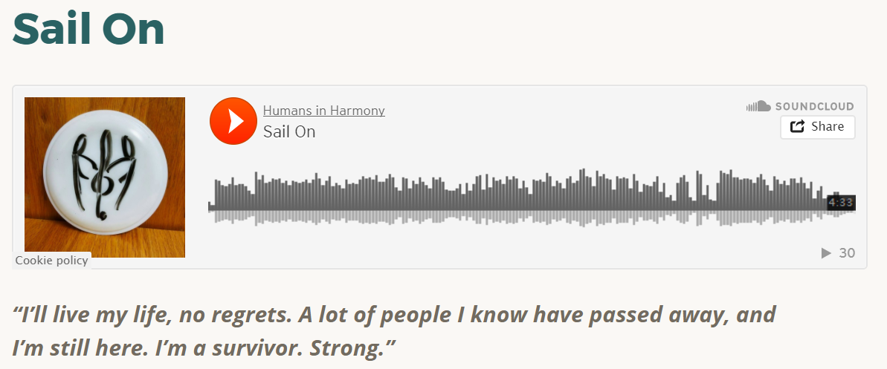

Example song
Listen to song at https://humansinharmony.org/2016/12/18/sail-on/
Notes:
Verse / chorus / verse / chorus / bridge / chorus
AA BB rhyme scheme

Slide 18
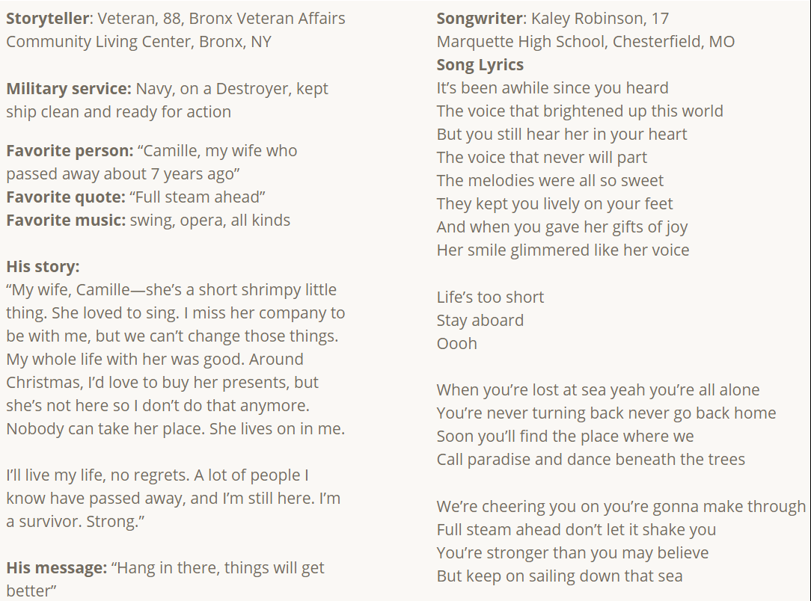


Tells the story and the details
General message that is repeated
Notes:
AABB rhyme
2nd person

