Slide 1

Instrumentals and Beats
Music Corps, June 2019
humansinharmony.org
Notes:
welcome everyone

Slide 2
Schedule
Orientation and introduction with student interns
  Week 1: June 11
Brainstorming, storytelling, song structure, lyrics
  Week 2: June 18
  Invite a community member from your organization to join you in this session as well as following sessions
Lyrics and melody
  Week 3: June 25
Melody and instrumentals
  Week 4: July 2
Instrumentals and workshopping
  Weeks 5-6: July 9-16
Recording
  Week 7: July 23
Performance
  Week 8: July 30
  Song-sharing performance at a host organization theater, open to all participants, community members, organization staff, and wider community
Notes:
Next two weeks are workshopping

Slide 3
Step-by-Step Guide to Songwriting
Record and perform song
Add chords, beats, instrumentals
Create a melody
Write the lyrics
Learn and discover

Slide 4
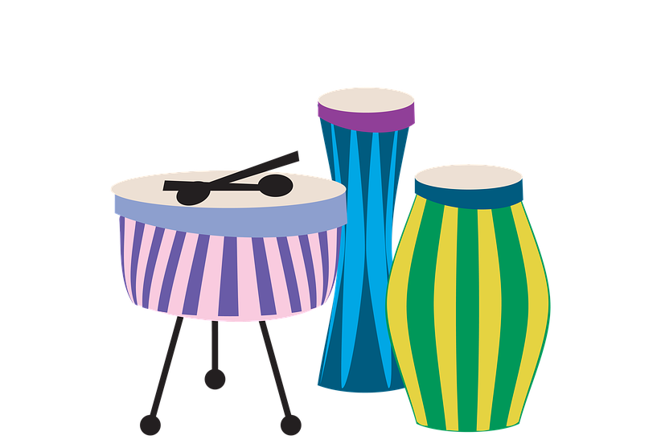
Song Elements
Now that you have the melody and chords
we can start adding more to the song
Instruments? Beats?
You could even add other vocal parts
Notes:
Now that we have a melody and chord, it is time to add some final elements to our song.
Do you want to add more vocal parts?
Add instruments?
Add a beat?
This presentation is about these elements

Slide 5

Instruments
Do you want your song to be accompanied
by an instrument?
Can play the chords for your melody
Can add harmony or support the melody
Notes:
Instruments can be a great addition to your song and can help enhance the musical aspects of it.
Not all instruments can play chords, but if you have a piano or guitar they could do that
Other instruments could just play a harmony or support the melody

Slide 6

Beats
Beats can add style
Computer generated or made with the body
A beat and a melody goes a long way
Examples: Claps, Stomps, rap beat
Notes:
You can also add beats to your song!
This can help add depth to your song
A beat can be computer or manually made.
Even just having a beat and only a melody can be a great song.

Slide 7

Cup Song

Slide 8

GarageBand
For Mac users only!
A convenient way to add digital beats and instruments
A great and easy way to see how different
instruments and beats sound
Notes:
If you don’t want to use physical instruments or beats, you can use music production software.
GarageBand is a good one to use, but is only for Mac Users.
You can use it to loop instrument sounds and add different things to your song.

Slide 9

LMMS
Free music production software for PC
Great way to add beats and instruments
Try out the various instruments and beats it has!
Notes:
In case you want to play around with it, here’s a demo
Even though many won’t use it

Slide 10
Personal Experiences
Sebastian on Music Production
humansinharmony.org
Notes:
welcome everyone

